Slide 1
Weekly report: Electrical Drivetrain
Week number: 4
Date: 21/10/2025
Supervisor: Prof. Dr.-Ing. Saiju
Group members: Aiswarya Vijayan, Vishranti Shivajirao Patil , Girish Mahadeo Padalkar, Cristina Milene Vergara Hernandez

Slide 2
List of contents
Concept of a Transformers in a wind turbine
Main function of a Transformers
Types of Transformers
Transformer Technical Specification
Our recommendation
How the Transformers is connected
Cables and Switchgear Recommendation
Conclusion & Next Steps
Vishranti Patil
Electrical Drive Train/ Optimus Syria

Slide 3
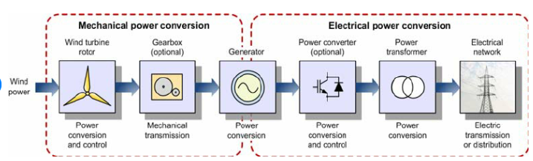
1.Concept of a Transformer in a Wind Turbine
Source :https://www.researchgate.net/figure/General-description-of-a-wind-turbine-system
Vishranti Patil
Electrical Drive Train/ Optimus Syria

Slide 4
2.Main function of a Transformer
Voltage Transformation
Grid Integration
Power Flow & Stability
Isolation & Protection
Vishranti Patil
Electrical Drive Train/ Optimus Syria

Slide 5
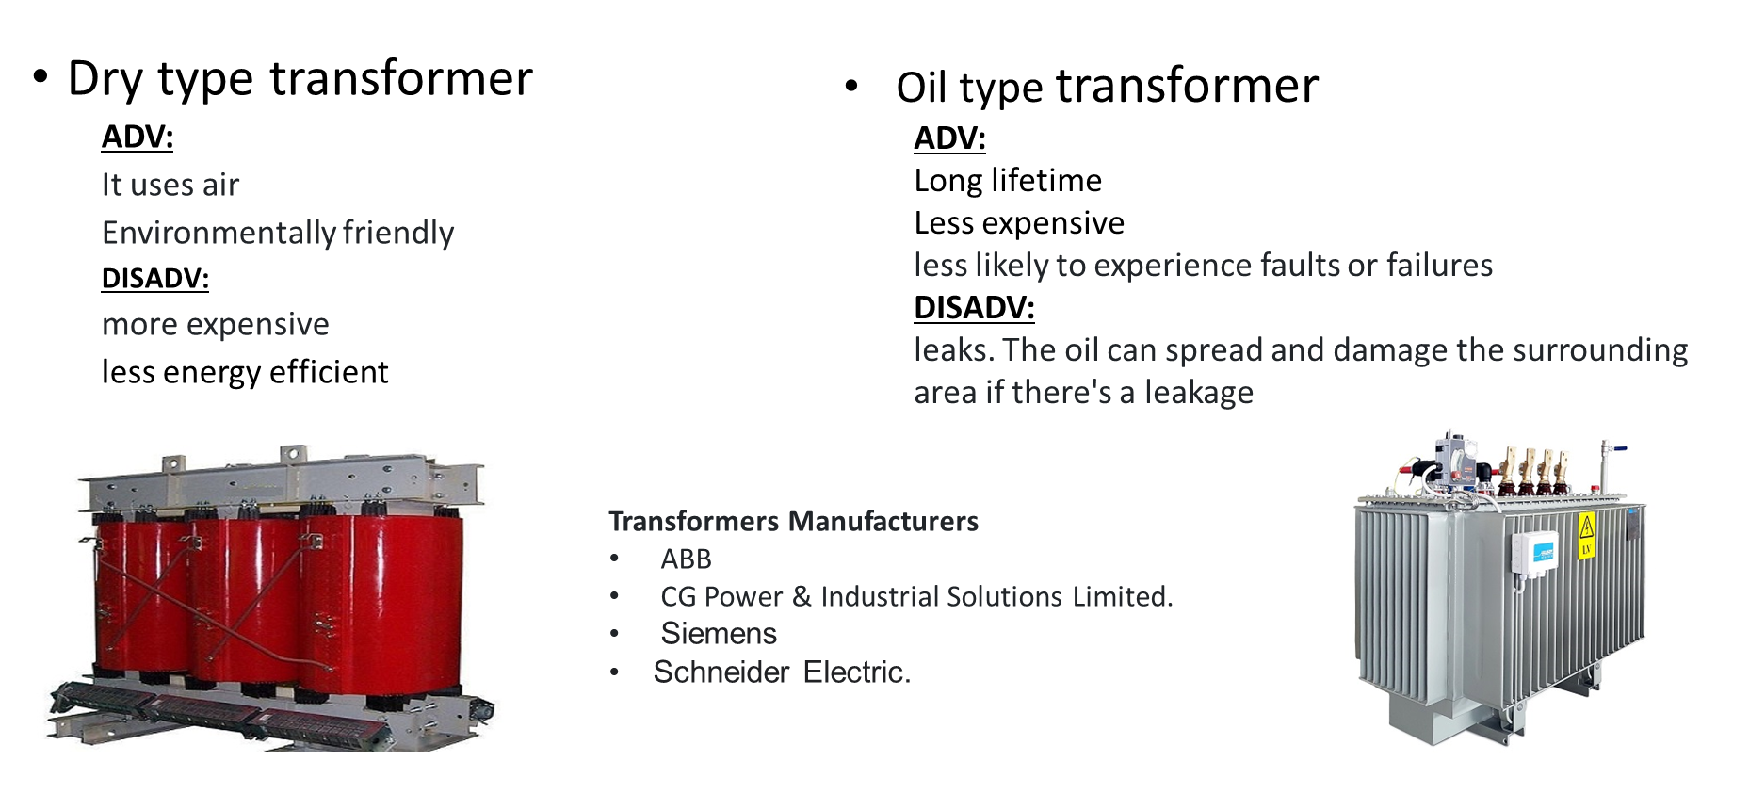
3.Types of Transformers
Vishranti Patil
Electrical Drive Train/ Optimus Syria

Slide 6
4. Transformer Technical Specification
Rated Power: 6000 kVA
Primary Voltage: 690 V
Secondary Voltage: 3.3 kV or higher
Frequency: 50 Hz
Cooling Type: ONAN (Oil Natural Air Natural)
Efficiency: >98%
Electrical Justification
Higher secondary voltage reduces current → lower I²R losses
Smaller cable cross-section → cost savings
Improved thermal performance
Vishranti Patil

Slide 7
A typical recommendation for a modern utility-scale wind turbine ( 5 MW ) would be: Liquid-Filled (Oil-Immersed) Step-Up Transformer 1. Transformer Type 2. Location 3. Design Considerations Why this choice? — Key justifications 1. High Cooling Efficiency 2. Excellent Overload Capability 3. Higher Efficiency (Low Load Losses) 4. Lower Cost per kVA/MVA 5. Superior Impulse/Short-Circuit Strength
5.Our recommendation
Vishranti Patil
Electrical Drive Train/ Optimus Syria

Slide 8
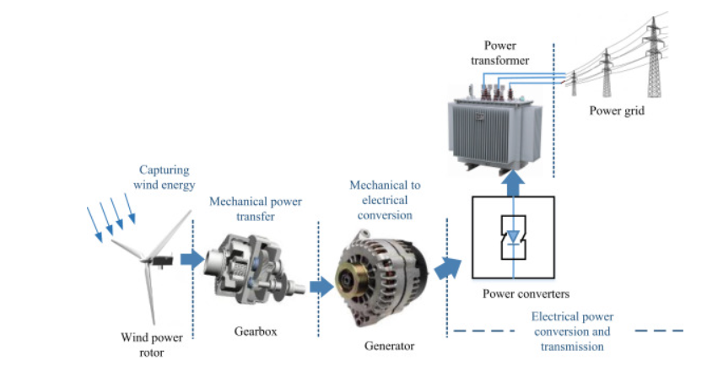
6.How the Transformer is Connected
Source :https://www.sciencedirect.com/topics/engineering/wind-turbine-system
Vishranti Patil
Electrical Drive Train/ Optimus Syria

Slide 9
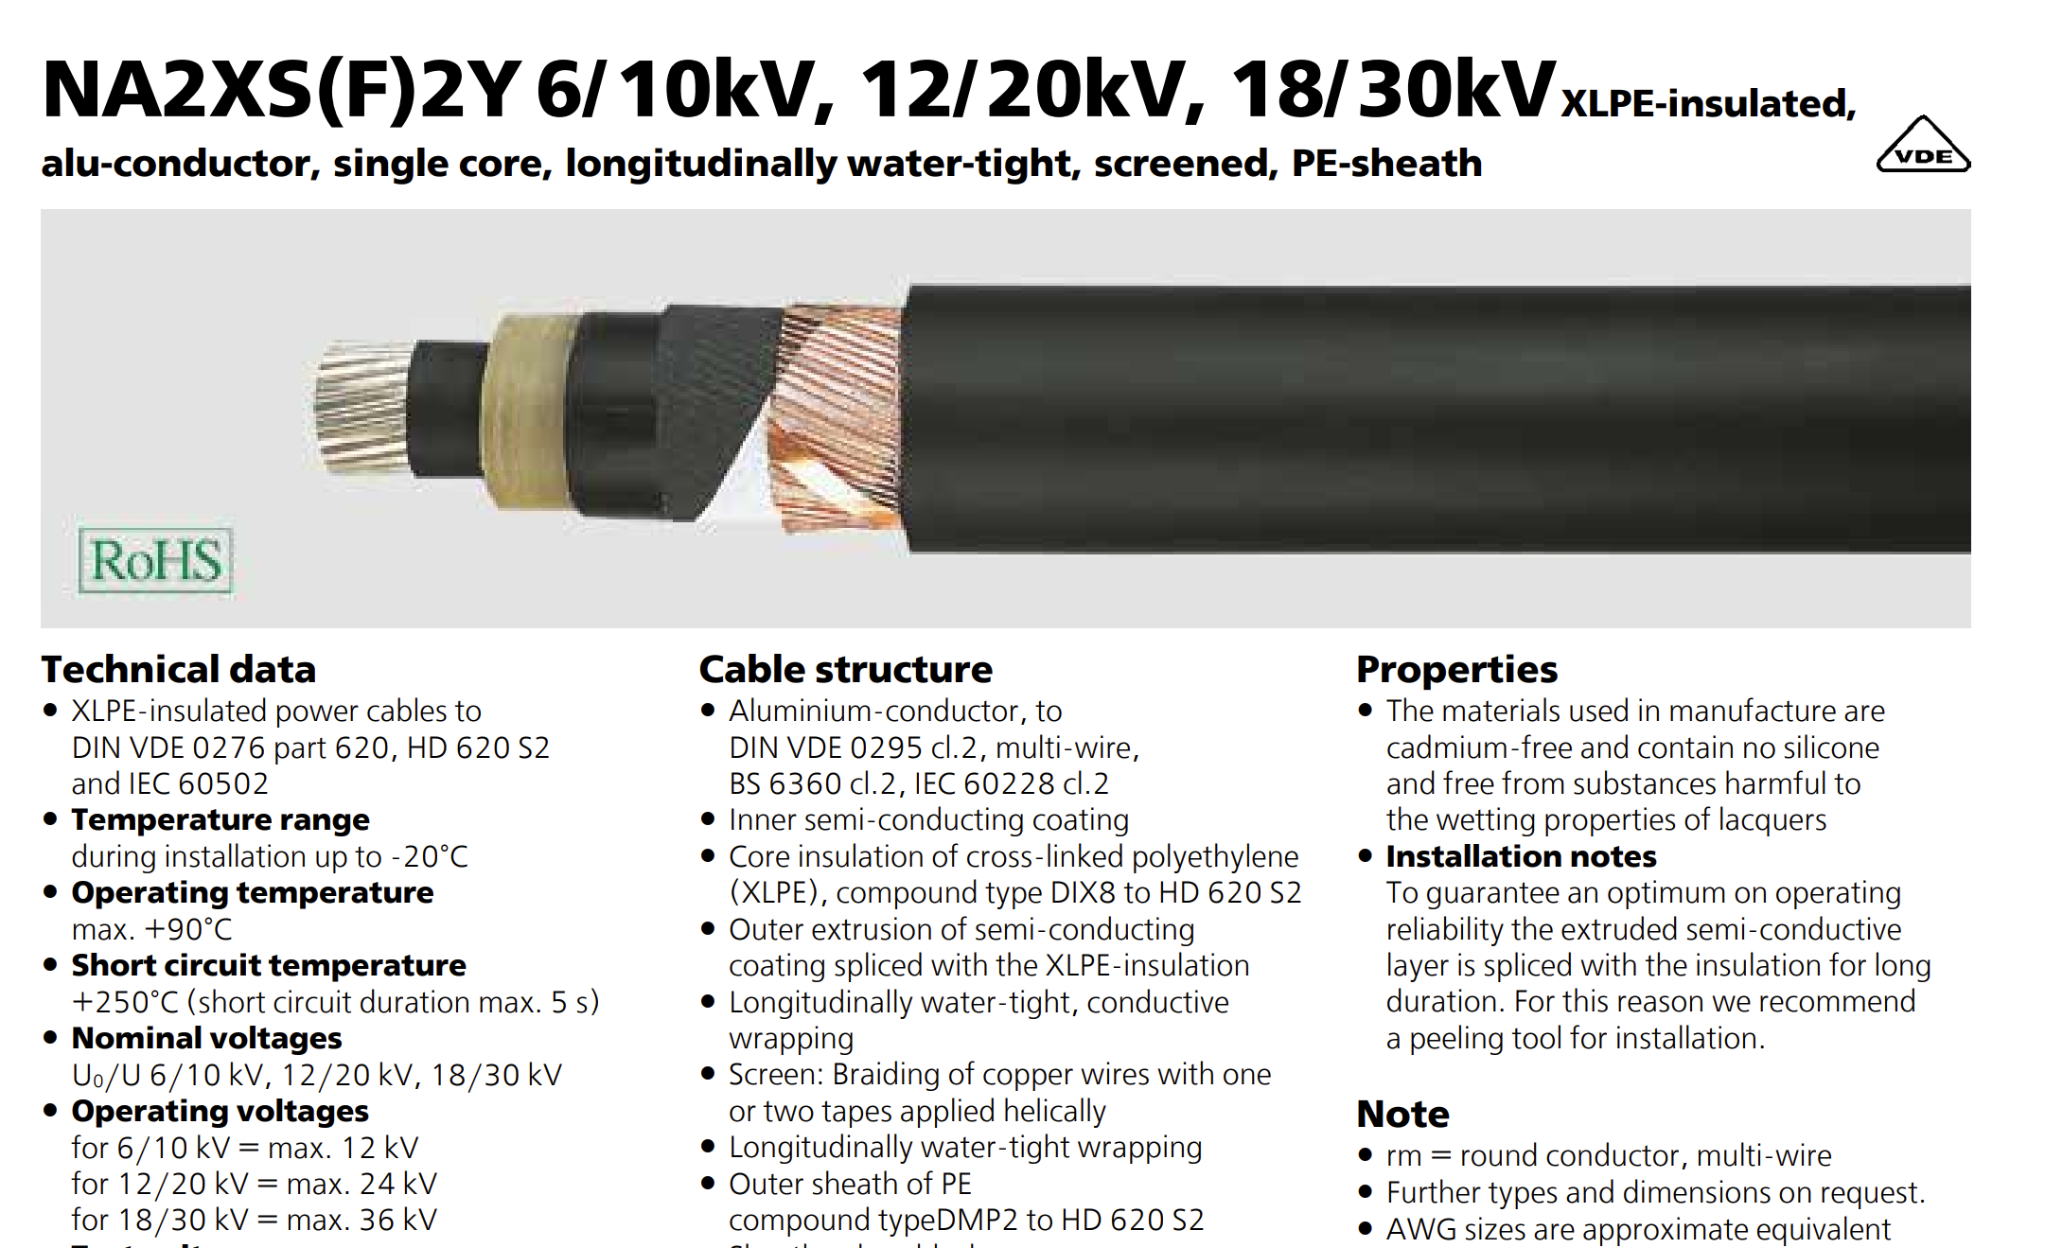
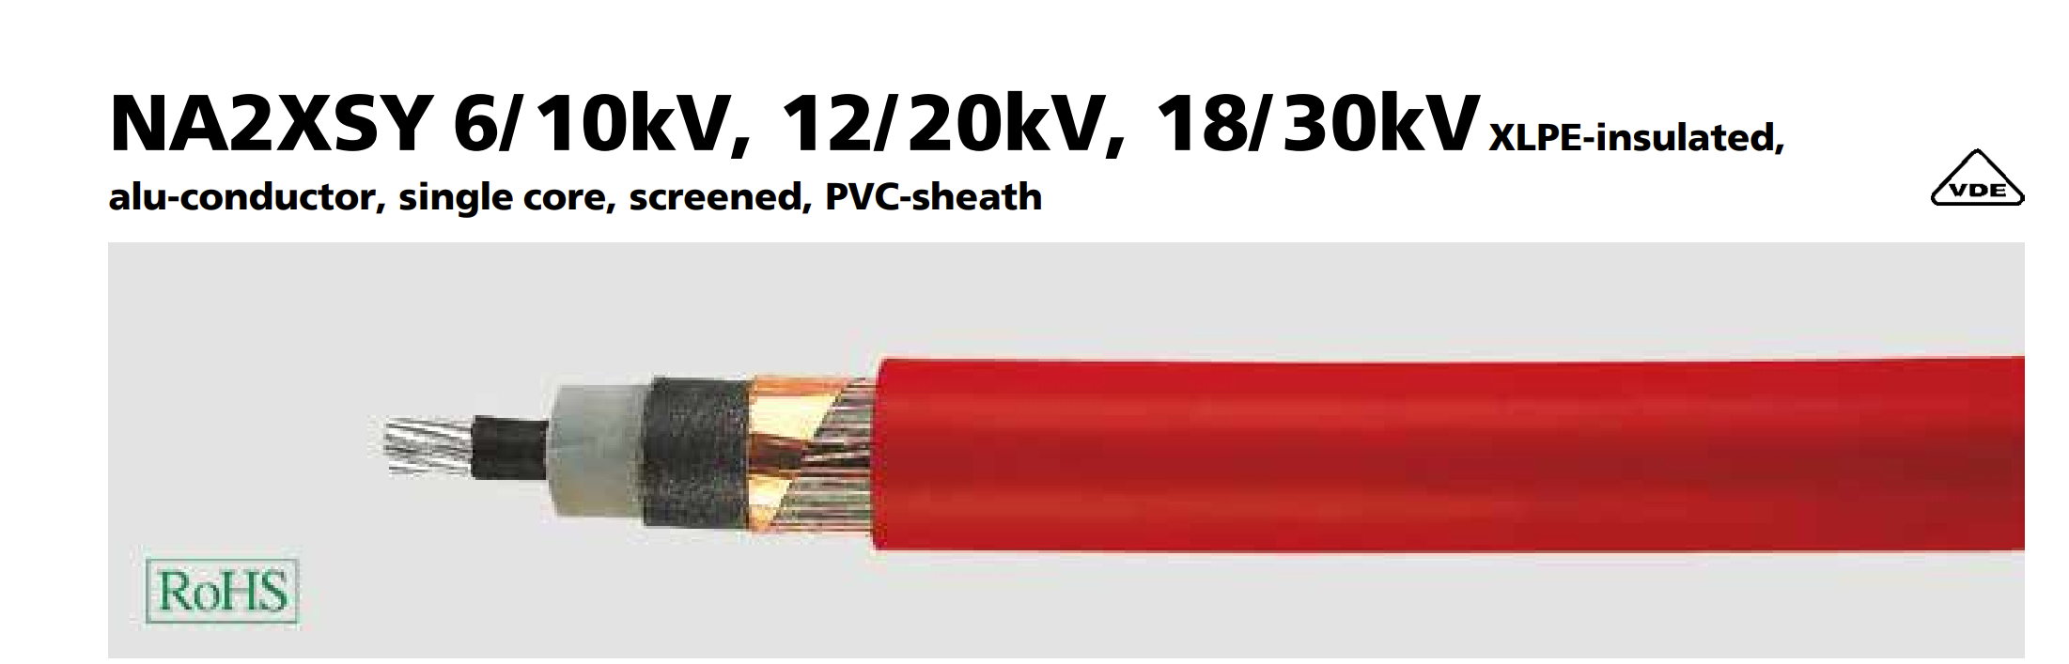
Cables and Switchgear Recommendation
Type: XLPE-insulated single-core aluminium (12/20 kV) Cross-section: 150–240 mm² Standard: IEC 60502-2 Installation: Underground, trefoil formation Lifespan: ~30 years, heat-resistant (90 °C)
Both comply with IEC 60502-2 and are suitable for 11–20 kV MV networks in Syria.
Source : https://www.helukabel.de/HELUKABEL/Publikationen/Flyer/Brosch
%C3%BCre-Aluminiumkabel-und-leitungen_EN.pdf

Slide 10
Cables and Switchgear Recommendation
Switchgear
Type:
- Medium-voltage switchgear (12–36 kV)
- Gas-insulated (SF6) or air-insulated (AIS) types
Purpose:
- Protects, isolates, and controls power flow
- Interrupts faults and allows safe maintenance
- Integrates with SCADA and protection relays
Main Components:
- Circuit breaker, disconnector, busbar, protection relay, CTs, and VTs
Standard: IEC 62271-200
Location: Between transformer and grid connection

Slide 11
8.Next Step
Planning:
align our milestone planning with the other teams
Technical:
Dimensions of converter.
First research about switchgear and cabling.
Transformer more detailed simulation and calculations.
Further with generator design details.
Vishranti Patil

Slide 12

Bibliography
[1] U.S. Department of Energy, "How a Wind Turbine Works (Text Version)," (Oct. 17, 2025). [2] G. Jose and R. Chacko, "A review on wind turbine transformers," in Proc. 2014 Annu. Int. Conf. Emerg. Res. Areas: Magn., Mach. Drives (AICERA/iCMMD), Kottayam, India, 2014, pp. 1-7. doi: 10.1109/AICERA.2014.6908172 [3] Energy Power Transformer, "Wind Power Transformers: Essential Guide for Renewable Energy Systems," (Oct. 17, 2025). [4] Daelim Transformer, "Wind Power Transformer," (Oct. 17, 2025). [5] Hitachi Energy, "Transformers for wind turbine generators," (Oct. 17, 2025). [6] Taishan Transformer, "Power Transformers in Renewable Energy Systems," (Oct. 17, 2025). [7] Hitachi Energy, "Transformers for offshore wind power," (Oct. 17, 2025). [8] ScienceDirect, "Wind Turbine System," (Oct. 17, 2025). [9] ResearchGate, "General description of a wind turbine system (Figure 2 from Pub. ID 221911675)," (Oct. 17, 2025).
10/21/2025
Vishranti Patil

